Slide 1
SOLAR MICRO GRID
D. SAI RAM CHANDU
N180866

Slide 2
What is the difference between electric grid and microgrid?
An electrical grid is an interconnected network for electricity delivery from producers to consumers.
A microgrid is a small, localized network of electricity generation, distribution, and consumption. It can be either grid-connected or off-grid. Grid-connected microgrids are connected to the main electric grid, but they can also operate independently if the main grid fails.

Slide 3
ADVANTAGES
Improved in reliability.
Increase in energy efficiency.
Integration of renewable energy.
Cost savings.
Improved energy access.
Economic development.
Increased energy independence.

Slide 4
MAIN OBJECTIVE
The main objective of a solar-based microgrid is to provide a reliable and efficient source of electricity that is independent from the traditional grid and can be implemented in isolated island areas.
It can include -
Energy security
Energy independence
Cost savings
Grid stability
Sustainability

Slide 5
Structural Outline of Solar off-grid system
PV GENERATION
BOOST CONVERTER
Bi-Directional Converter
SINGLE PHASE INVERTER
BATTERY
STEP UP TRANSFORMER
LOAD

Slide 6
A Comprehensive Exploration of Solar Micro Grid
Initially, we prioritize solar photovoltaic (PV) as our primary energy source due to its affordability, high efficiency, and value for money. To maximize its power output, we employ a technique called Maximum Power Point Tracking (MPPT). This method boosts the PV voltage to achieve the maximum power point. Additionally, we connect a battery in parallel to the boost converter, utilizing a bidirectional converter that serves a dual purpose. When the PV system generates power, the battery charges, and in the event of PV power generation cessation, the battery can supply power through the bidirectional converter.
To make the power usable for end-users, we proceed to invert the voltage using an inverter. To ensure a clean power output, we have implemented an LC filter to eliminate higher-order harmonics. This filter guarantees the generation of a perfect sinusoidal wave at 50Hz, which is the standard frequency for most power systems.
Furthermore, by utilizing a step-up transformer, we increase the voltage and current levels, allowing for efficient transmission to the end-user. This step-up transformer ensures that power losses during transmission are minimized, and the electricity reaches the intended destination with appropriate voltage and current levels.

Slide 7
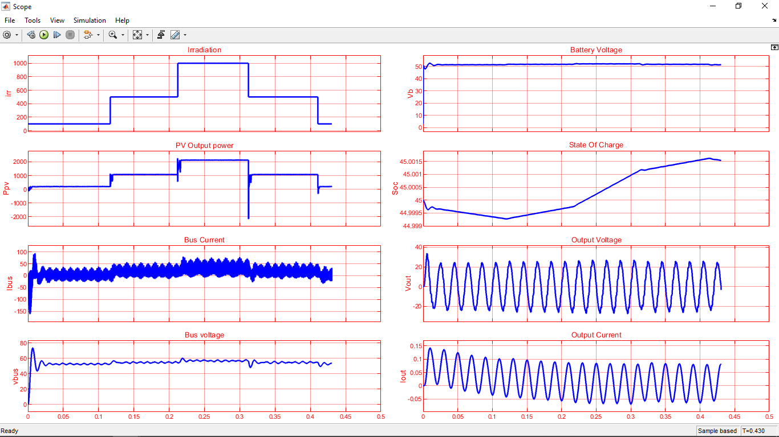
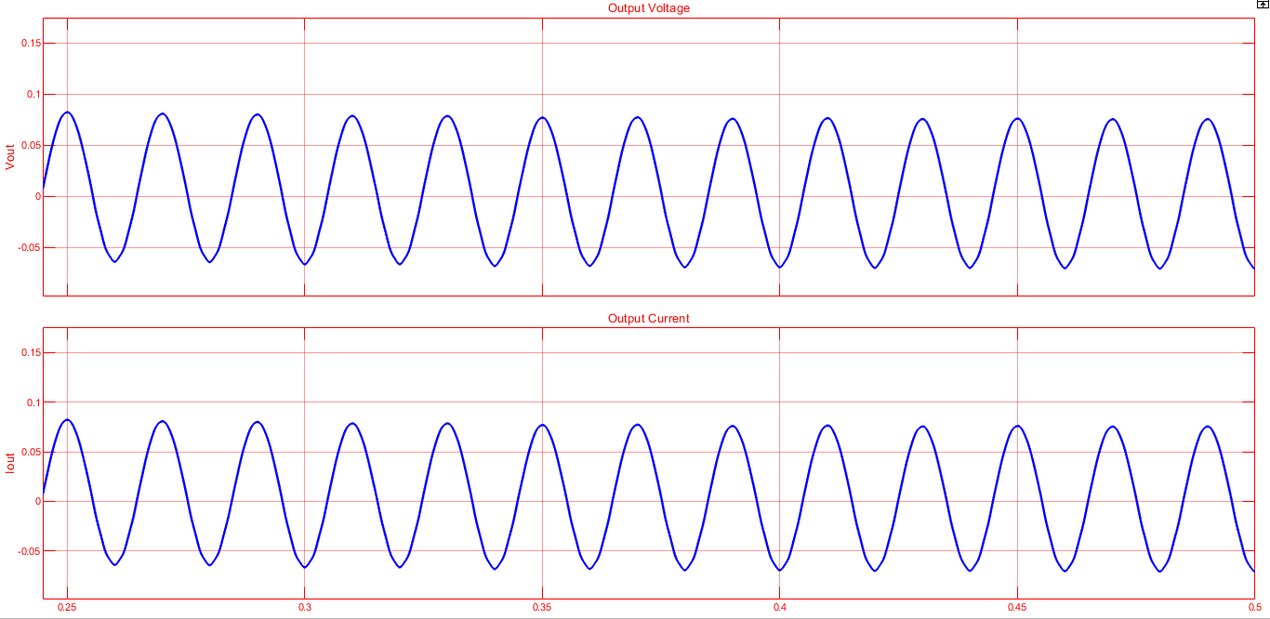
Output From The Matlab Simulations
PV Array Behavior
Inverter Output

Slide 8
Challenges of Island Energy Systems
Variability and Intermittency of Solar Power
Limited Power Generation Capacity
Energy Demand Management
Grid Stability and Frequency Control
Limited Technical Expertise and Resources
Cost and Financing

Slide 9
Conclusion
Microgrids offer numerous advantages over traditional grids, such as increased resilience, energy independence, and the ability to integrate renewable energy sources. However, they also come with their own set of challenges. In my project, I have implemented a photovoltaic (PV) microgrid using MATLAB, and I believe that it is a superior and efficient solution for promoting the utilization of renewable energies.
Solar Micro Grid can continue to supply power to local communities even during grid outages or disruptions. This capability is especially crucial in remote or disaster-prone areas where maintaining a reliable power supply is challenging.
The implementation of a PV microgrid in MATLAB allows for comprehensive modeling and simulation, enabling the evaluation of its performance under various scenarios. This approach facilitates accurate sizing of the PV system, energy storage components, and other infrastructure elements to meet the specific needs of the target community.

Slide 10
THANK YOU

